Slide 1
Cloud
Federation

Slide 2
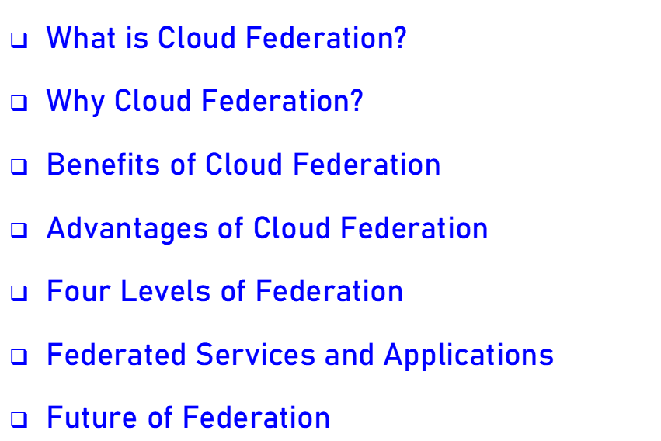
Contents

Slide 3
What is Cloud Federation?
Cloud federation is the practice of interconnecting the cloud computing environments of two or more service providers for the purpose of load balancing traffic and accommodating spikes in demand.

Slide 4
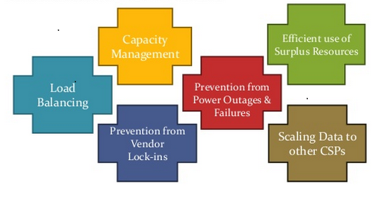
Why Cloud Federation

Slide 5

Cloud federation offers two substantial benefits to cloud providers:
First, it allows providers to earn revenue from computing resources that would otherwise be idle or underutilized.
Second, cloud federation enables cloud providers to expand their geographic footprints and accommodate sudden spikes in demand without having to build new points-of-presence (POPs).

Slide 6
Advantages of Cloud Federation
Cost-effectiveness
Diverse geographical locations
Avoidance of vendor lock-in
Better SLA to customers
Guaranteed availability
Underutilized

Slide 7
Cloud Federation levels
There are four basic types/levels of federation:
1)Permissive
2)Verified
3)Encrypted
4)Trusted Underutilized

Slide 8
Thank
You

